Slide 1
What keeps New Zealand’s fruit and vegetable growers awake at night?
Weather disasters
Labour shortage
Spiralling costs
4200+
40,000
100
125
$6b
growers
regional jobs
types of fruit and vegetables grown
export markets around the world
Total value

Slide 2
We are New Zealand’s growers…
We want every New Zealander to enjoy delicious and nutritious fruit and vegetables, sustainably grown here in Aotearoa. We want New Zealand to prosper by exporting our world leading apples, kiwifruit, avocados, onions, cherries and many other products to millions of customers all over the world.
…we love our mahi…
We care about the land. Aotearoa is blessed with optimum growing conditions and prime soil. We have a vision for a world-leading commercial fruit and vegetable growing industry – healthy and sustainable food for our nation and for the world.
…but we are deeply concerned about our future
Our industry is under immense pressure. Without swift and definitive action, we could fail and put New Zealand’s food security at risk. Don’t let that happen. The New Zealand horticulture industry wants to closer partner with Government to see horticulture reach its potential.
Our main concerns:
Under the Aotearoa Horticulture Action Plan, our industry, Government, Māori and research providers have the common goal to improve prosperity and protect our environment. The goal is to double the farmgate value of horticultural production from $6 to $12b by 2035. If you haven’t already, please familiarize yourself with the plan.
We request that Governments:
Appoint a Minister of Horticulture – supported by dedicated officials – to increase recognition and understanding of horticulture, with the aim of focusing policy and resources under the key five action plan outcomes.
Increase resilience against climate change
Increasing in severity and frequency, adverse weather affects growers and highlights how vulnerable New Zealanders’ food security is. As an industry, horticulture wants to ‘grow back better’, restoring and protecting growers in the short term, and creating a higher value, more resilient and innovative industry in the medium to long term.
We request that Governments:
Prioritise the building of resilient regional infrastructure, including roading and flood protection Support the managed retreat from flood-prone areas Quickly direct and support recovery efforts when adverse events do occur, so economic and social losses are not compounded.
Horticulture New Zealand • Industry Manifesto 2023

Slide 3
Let us invest in land and water
We cannot grow without use of New Zealand’s highly productive land. We cannot grow without access to water. Current central and local Government policy settings and attitudes – particularly in the areas of land and water use – do not support horticulture’s growth.
Accelerate science and knowledge
A strong research and development programme and consideration of Mātauranga Māori enables, accelerates and supports horticulture. New Zealand’s biosecurity system must be strong, while enabling trade and travel.
We request that Governments:
Ensure flexibility in land use Prioritise highly productive land for primary production, protecting it from urban sprawl, flooding and the adverse effects of upstream land use Allow construction of packhouses, glasshouses, seasonal worker accommodation, and covered crop protection, in recognition that buildings and infrastructure are integral parts of horticulture. Prioritise water allocation Develop policy settings that support expansion of and investment in water storage Ensure water consent timeframes give growers the certainty to invest and increase production, while improving environmental outcomes.
We request that Governments:
Recognise the GAP certification framework in place of the proposed Freshwater Farm Plans and for biodiversity planning to streamline processes and avoid duplication in assurance programmes Increase Government funding for applied horticulture R&D, particularly in the areas of crop protection, robotics, advanced breeding and digital technologies Remove regulatory barriers to the adoption of new technologies and access to international markets Speed up regulatory approval of new, more environmentally sustainable crop protection products, particularly when these products have already been approved for use in export markets Better resource all border entry points to protect horticulture from pest incursions.
Optimise value for New Zealanders
Double revenue to $12 billion by 2035: When growers prosper - thanks to sustainable and profitable production of nutritious fruit and vegetables - all our communities prosper. Horticulture is fundamental to New Zealand’s health, social, economic and environmental and goals. Horticulture helps New Zealand respond to climate change and meet international obligations. With the right policy and regulatory settings, growers can provide food security for New Zealanders and contribute to export success.
Nurture our people
Horticulture employs 40,000 New Zealanders, but we face a chronic labour shortage. To reach our potential, we must attract and retain many more motivated and skilled people to work in horticulture, from both New Zealand as well as overseas, especially during seasonal harvest peaks. Horticulture is a rewarding career with opportunities in technology, research and commerce. We need a much larger base of people with the skills to drive the industry forward.
We request that Governments:
Lower tariffs and negotiate swift access to new export markets to increase exports in line with industry and Government aspirations Make the sustainable and profitable growing of fruit and vegetables a national outcome, so it is prioritised in the National Planning Framework and Natural and Built Environment Act, and reflected in regional planning Develop a National Policy Statement for Vegetables to make sure policies affecting vegetable production are consistent and workable across the whole country.
We request that Governments:
Remove current legislative barriers to businesses employing and rewarding people, for example, Fair Pay Agreements Ensure the Recognised Seasonal Employer (RSE) scheme is sustainable for both the Pacific and horticulture industry, building on the success of the past 16 years Immigration policies and processes must be changed to make it more attractive for people to come and work in New Zealand Vocational training schemes must reflect horticulture’s complexity and grow a much larger base of people with the skills to drive the industry forward.
Horticulture New Zealand • Industry Manifesto 2023

Slide 4
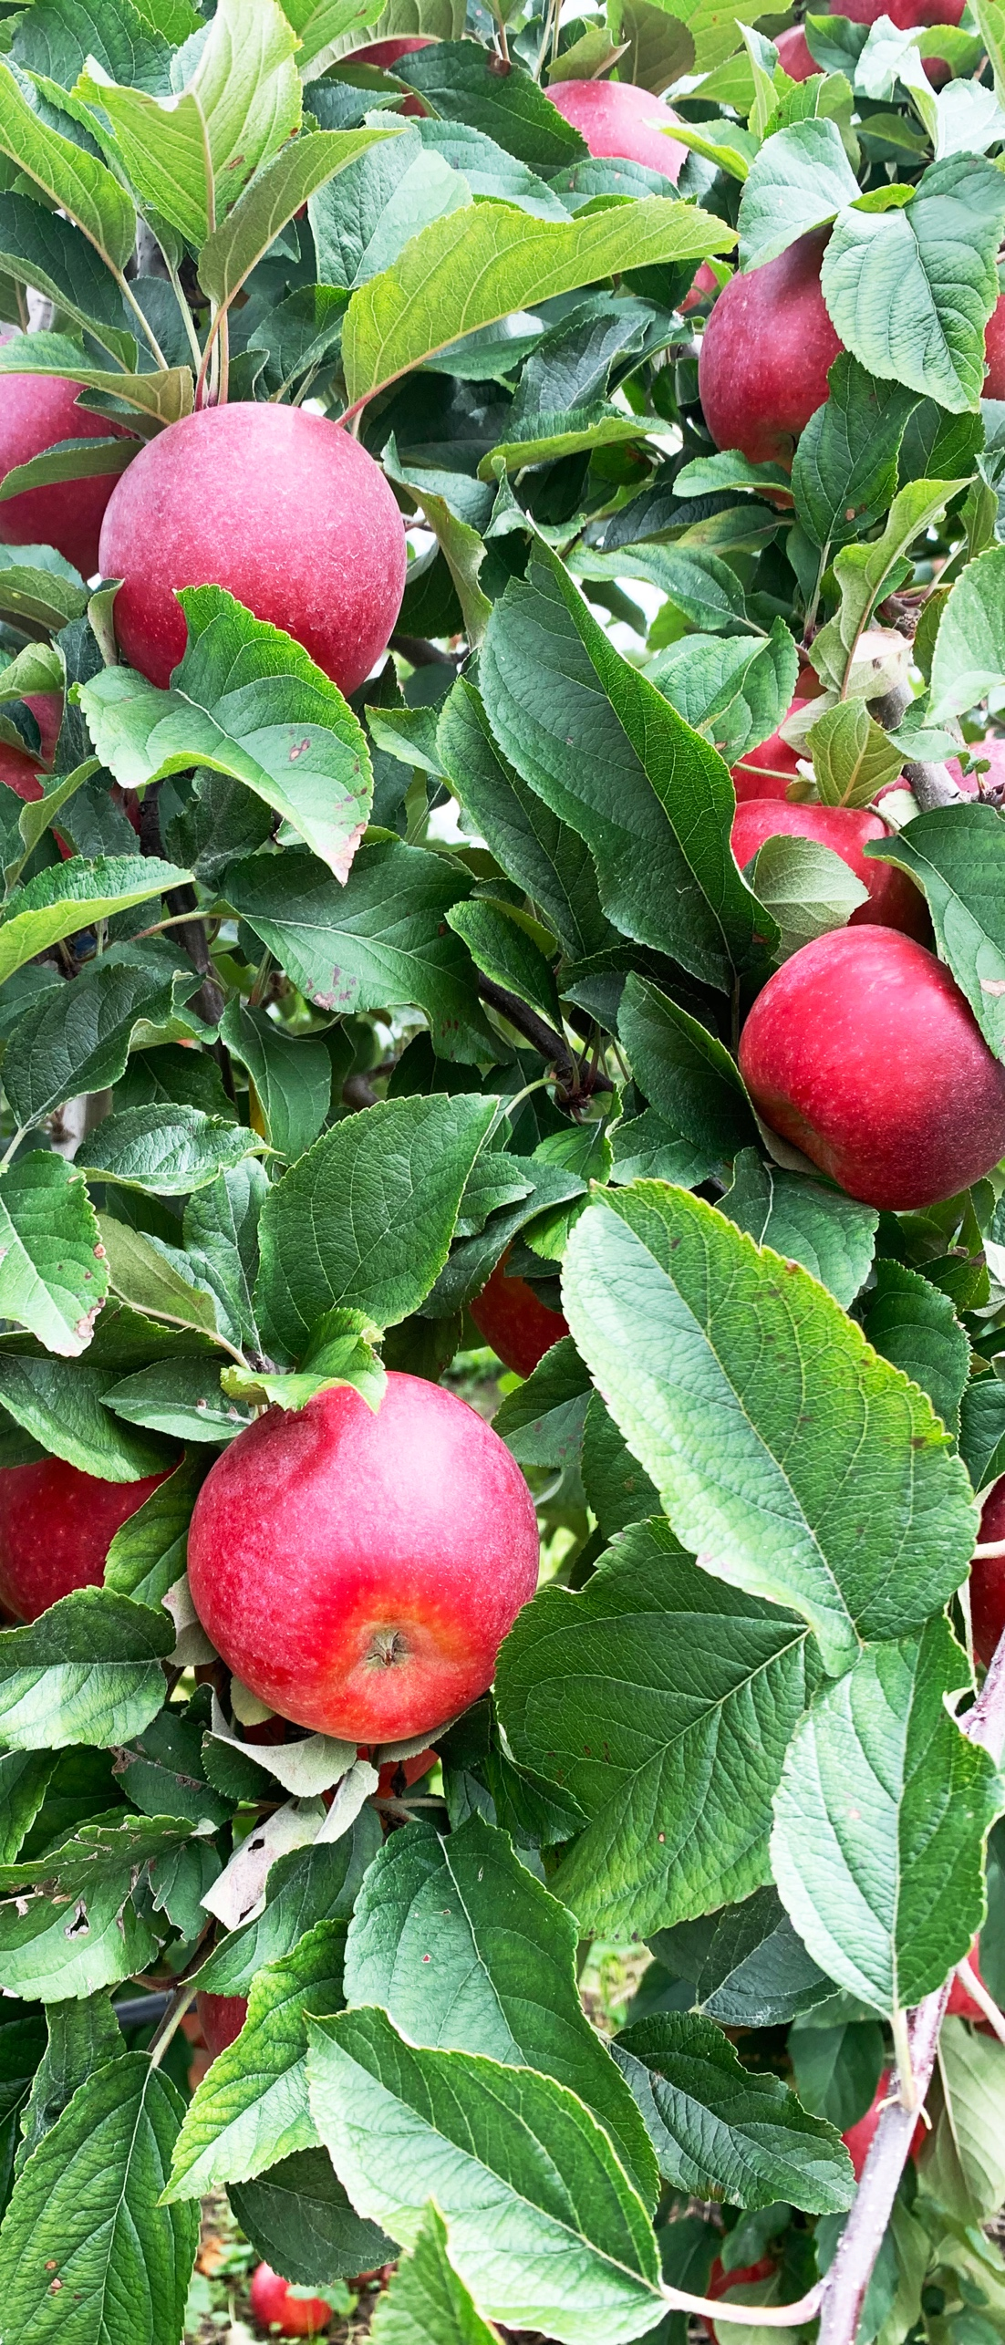
Oranga kai, oranga tangata, haere ake nei Healthy food for all, forever
Working with Government to develop policy and practices, we can create an enduring environment where growers thrive and New Zealand prospers.
To find out more or organise a visit
If you would like to speak to HortNZ Chief Executive, Nadine Tunley, please phone her Executive Assistant, Edison Harris on 027 939 9577.
If you are interested in learning more about fruit and vegetable growing in New Zealand, or would like to visit a grower, please contact HortNZ General Manager Engagement, Kate Longman: kate.longman@hortnz.co.nz or 029 770 9874.

